Slide 1
Automating Fabric Solution Deployment Guidance and Best Practices with CI/CD for Deploying and Updating Fabric Solutions

Slide 2
Agenda
Fabric Strategies for CI/CD and Automating Solution Deployment
Creating Workspace Items using the Fabric REST APIs
Challenges in Fabric CI/CD and Solution Deployment
Configuring Datasource Paths using Deployment Parameters
Deploying and Updating Solutions from a Source Workspace
Exporting and Deploying Solutions using Solution Folders
Connecting Workspaces using Fabric GIT Integration
Setting Up Staged Deployments

Slide 3










Workspaces with Sample Fabric Solution Scenarios
Fabric Power BI Solution
Fabric Lakehouse Solution with Notebook
Fabric Lakehouse Solution with Shortcut and Notebooks
Fabric Lakehouse Solution with Data Pipeline and Notebooks
Semantic Model
Report
Lakehouse
Notebook
Semantic Model
Report
Lakehouse
Shortcut
Notebook
Notebook
Semantic Model
Report
Report
Report
Lakehouse
Notebook
Notebook
Data Pipeline
Semantic Model
Report
Report
Report

Slide 4
Workspace Item Types
Fabric solutions designed and implemented in terms of workspace items
Developers can discover, create and manage workspace items inside scope of a workspace
Workspace items are created and updated using item definitions
Creatable Workspace Item Types by Workload
Data Engineering
Power BI
Data Factory
Data Warehouse
Real-time Intelligence
Data Science
Lakehouse
SemanticModel
DataPipeline
Warehouse
Eventhouse
MLExperiment
Notebook
Report
Dataflow
MirroredWarehouse
Eventstream
MLModel
SparkJobDefinition
KQLDatabase
Environment
KQLQueryset
KQLDashbord

Slide 5
Programming with Fabric Item Definitions
Fabric items can be created and updated using item definitions
You can pass item definition when calling Create Item API
You can modify existing workspace item by calling Update Item Definition passing item definition
You can retrieve item definition for existing workspace item by calling Get Item Definition
Your Application
Fabric REST APIs
Item
Definition
POST - Create Item
Item
Definition
POST - Update Item Definition
Item
Definition
POST - Get Item Definition

Slide 6
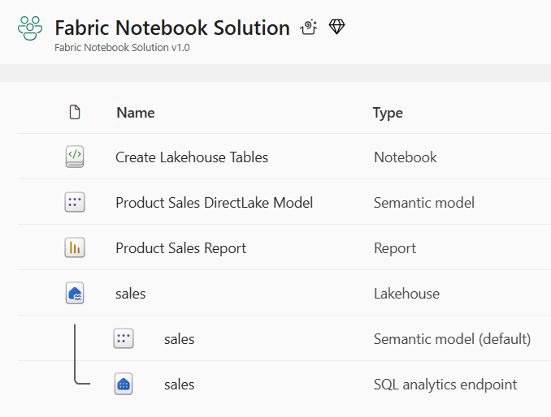
Developing a Custom API-driven Pipeline
Deploy workflow creates new target workspace and clones source workspace items
Deploy workflow always creates target workspace and builds it from scratch
Fabric REST APIs provide necessary CRUD APIs for managing workspace items
Update workflow processes set of updates on target workspace that already exists
Source workspace items that already exist in target workspace are updated
Source workspace items that do not already exist in target workspace are created
Source Workspace
Target Workspace
Deploy
Items
Source Workspace
Target Workspace
Update
Items

Slide 7
First Motivation for Custom API-driven Pipelines
Staged deployment used to push changes between environments like DEV>TEST >PROD
DEPLOY workflow creates downstream workspaces on demand
UPDATE workflow pushes out full update to all workspace items or partial update
DEPLOY and UPDATE workflows can cross environments such as Entra Id tenant boundaries
Building each stage requires configuring different datasource paths
DEPLOY workflow for must configure datasources differently for DEV, TEST and PROD
Entra Id tenant A
Entra Id tenant B
Entra Id tenant C
Dev Workspace
Test Workspace
Deploy
Items
Prod Workspace
Deploy
Items
Deploy
or
Update
Deploy
or
Update

Slide 8

Second Motivation for Custom API-driven Pipelines
Fabric provides development platform for building multi-tenant applications
Each customer tenant created using one or more Fabric workspaces
Developer uses Fabric REST APIs to create and configure workspaces and workspace items
Fabric Multi-tenant Environment
Entra Id Tenant Owned by ISV
Customer 1 Tenant Workspace
Customer 01
17 users
Lakehouse
Notebook
Semantic Model
Report
Custom
Multitenant Application
Customer 2 Tenant Workspace
Lakehouse
Notebook
Semantic Model
Report
Customer 02
85 users
Customer N Tenant Workspace
Lakehouse
Notebook
Semantic Model
Report
Customer N
450 users

Slide 9
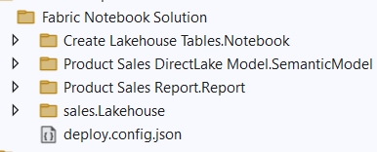
Exporting a Set of Workspace Items to Solution Folder
Source of truth for Fabric solution needs to be persisted as set of files in source control
Item definition files must be saved into source control repository
Export contains item definition files
Export contains whatever extra metadata required to recreate solution in target workspace
Extra metadata required for workspace and workspace item properties, item Ids, shortcuts and connections
Source Workspace
Packaged Solution Folder
Solution
Export
Logic
Solution Deployment Logic
Target
Workspace

Slide 10
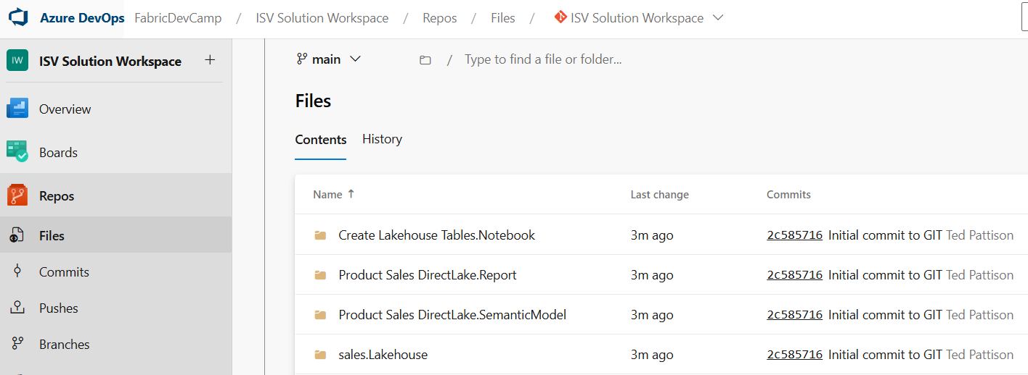
Options for API-driven Solution Deployment
Option 1: Deploy from source workspace
Option 2: Export workspace to local solution folder and then deploy from local solution folder
Option 3: Export workspace to ADO solution folder and then deploy from ADO solution folder
Source Workspace
Solution Deployment Logic
Target
Workspace
Source Workspace
Packaged Solution Folder
Solution
Export
Logic
Solution Deployment Logic
Target
Workspace
Source Workspace
Solution
Export
Logic
Solution Deployment Logic
Target
Workspace

Slide 11
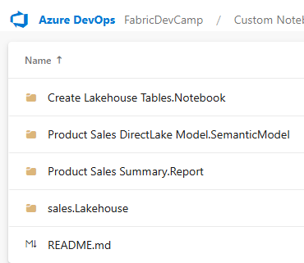
Connecting Fabric Workspace to GIT Repositories
Fabric workspace can be connected to GIT repository with 2-way synchronization
Fabric currently supports GIT repositories in Azure Dev Ops and GitHub
Once connected, workspace items serialized as item definition files in GIT repository
Changes made to workspace items can be synchronized to GIT repository files
Changes committed to GIT repository files can be synchronized to workspace items
GIT Integrated Serialization

Slide 12
Staged Deployment High-level Diagram
Dev Workspace
Test Workspace
Prod Workspace
Customer 1 Workspace
feature01 Branch
GIT Integrated Serialization
Custom
Export
Logic
Custom
Import
Logic
Custom
Export
Logic
Custom Deserialization
Logic
Feature01 Workspace
Deploy
or
Update
main Branch
pull requests
Customer 2 Workspace
Deploy
or
Update
feature01 Branch
Feature01 Workspace
pull requests
Deploy
or
Update
Customer N Workspace

Slide 13
Agenda
Fabric Strategies for CI/CD and Automating Solution Deployment
Creating Workspace Items using the Fabric REST APIs
Challenges in Fabric CI/CD and Solution Deployment
Configuring Datasource Paths using Deployment Parameters
Deploying and Updating Solutions from a Source Workspace
Exporting and Deploying Solutions using Solution Folders
Connecting Workspaces using Fabric GIT Integration
Setting Up Staged Deployments

Slide 14
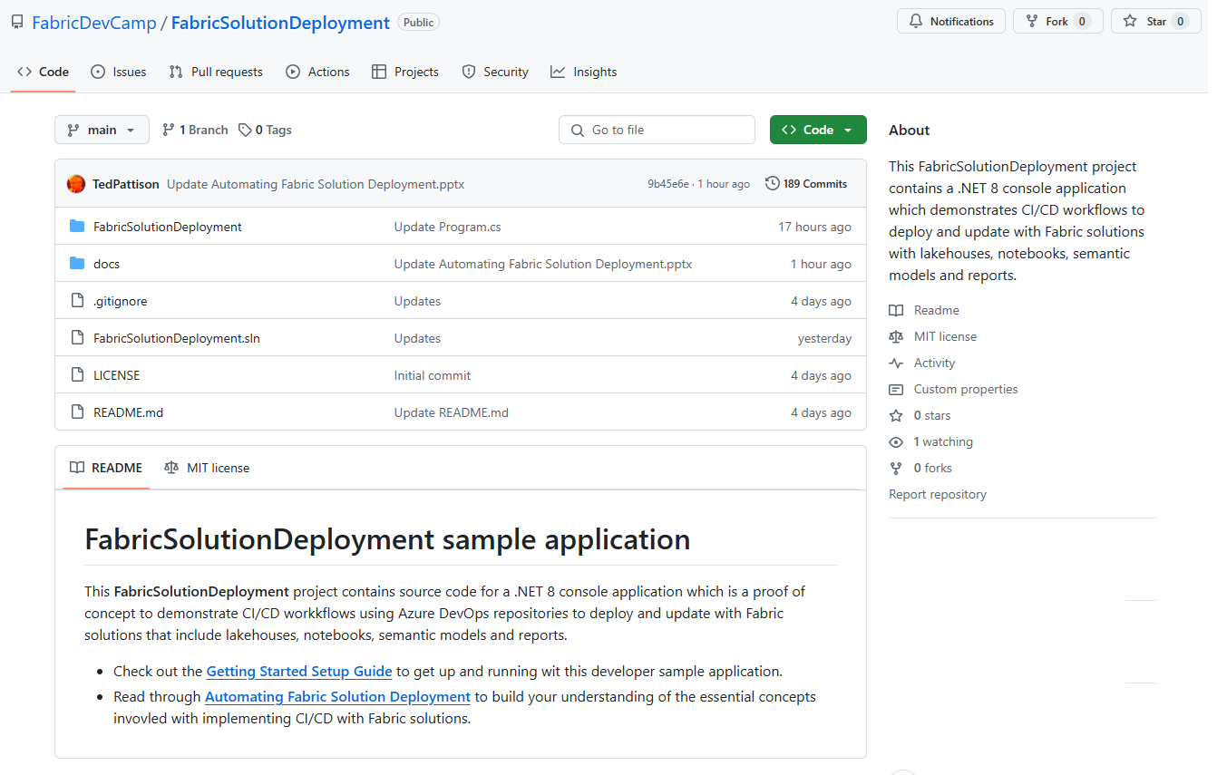
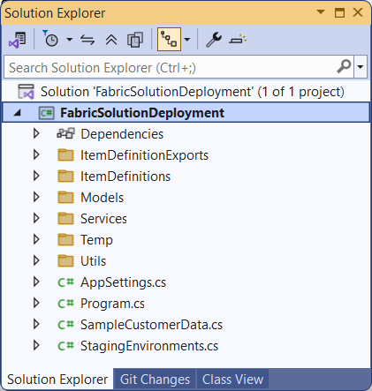
The FabricSolutionDeployment Developer Sample
Sample application demonstrating how to implement solution deployment workflows
Created as a .NET 8 console application using the Fabric REST API .NET SDK
Provides easy learning path for developers to download project and get up and running
https://github.com/FabricDevCamp/FabricSolutionDeployment

Slide 15
Assumptions for FabricSolutionDeployment Sample
FabricSolutionDeployment based on constrained set of workspace item types
Lakehouse (with shortcuts)
Notebook
Data Pipeline
Semantic Model
Report
FabricSolutionDeployment uses predetermined set of connection types
Web connections with anonymous access
AzureDataLakeStorage connections with account key credentials
SQL connections to SQL endpoint of lakehouse with service principal credentials

Slide 16

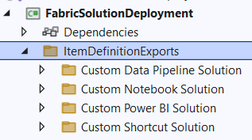
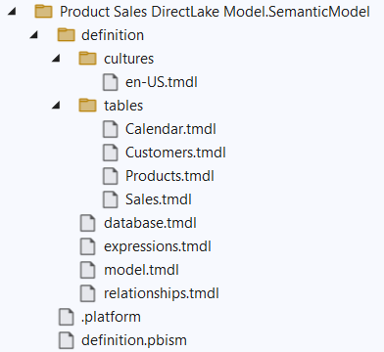
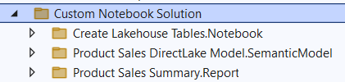
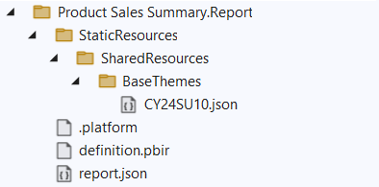
Item Definition Files
Fabric ALM strategy with CI/CD based on item definition files
Fabric automatically serializes workspace items into set of item definition files
Each type of workspace item defines the set of files that constitutes a valid item definition

Slide 17
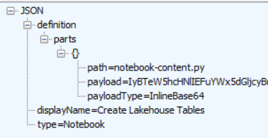
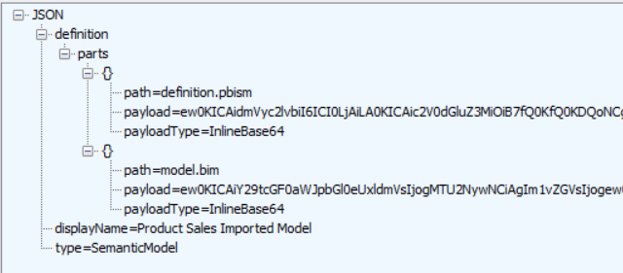
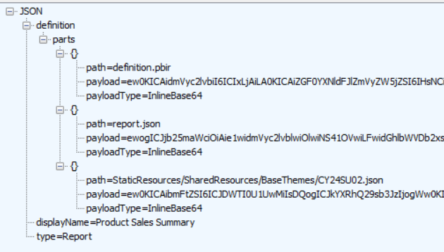
Passing Item Definitions to the Create Item API
Tricky low-level developer details
Item definitions passed across network using JSON.
Item definitions contain collection of file known as item definition parts
Item definition part content must be base64 encoded to pass across network
Developer must deal with encoding/decoding to/from base64 encoded format

Slide 18
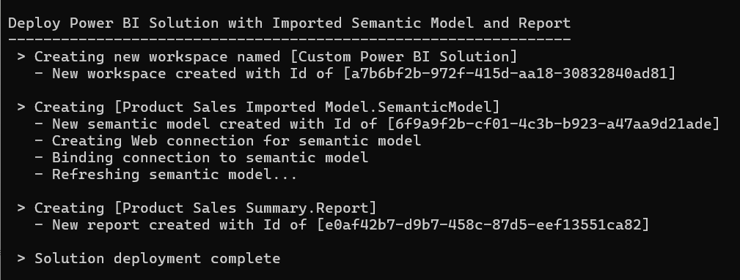
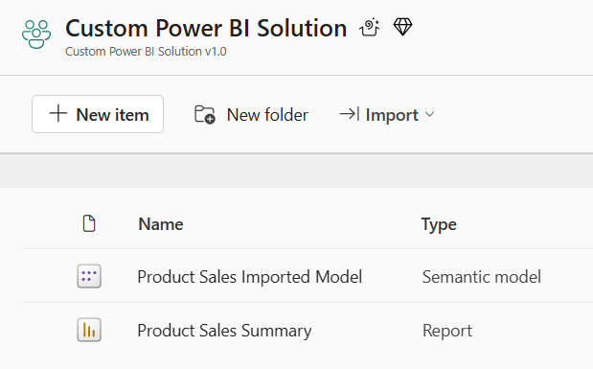
Deploy the Power BI Solution

Slide 19
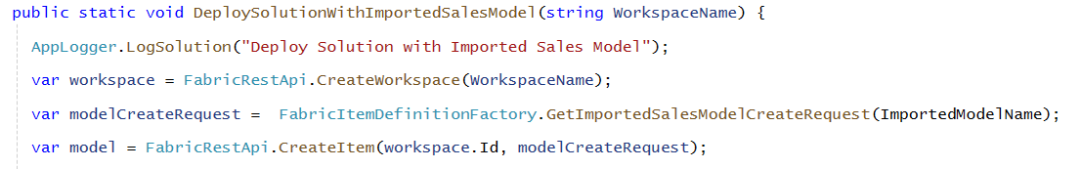
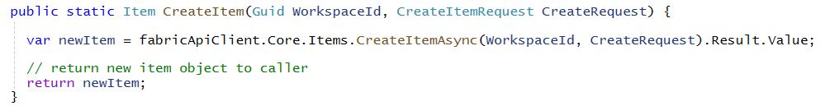
Creating Semantic Model using CreateItem
Call FabricUserApi.CreateItem passing FabricItemCreateRequest instance
CreateItem method calls CreateItem API using Core.Items client from .NETSDK

Slide 20
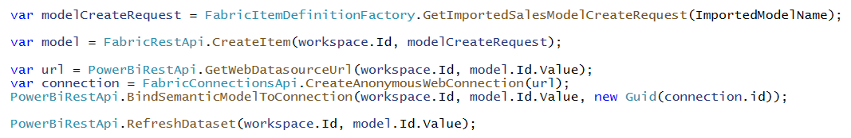
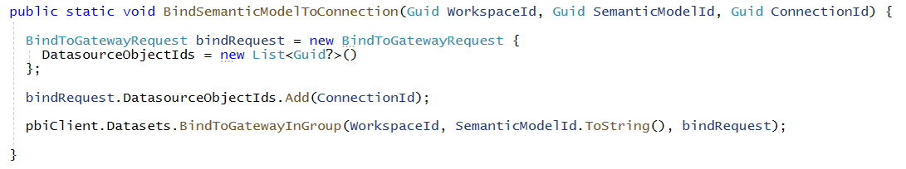
Preparing the Semantic Model After Creation
Imported semantic model needs to be refreshed after creating from item definition
Call to CreateItem creates semantic model but does not populate model with imported data
Currently, Power BI REST API required to bind connection and refresh semantic model
Developer binds semantic model to connection using BindToGatewayInGroup API
In the fullness of time, this binding and refresh functionality will be added to the Fabric REST API

Slide 21
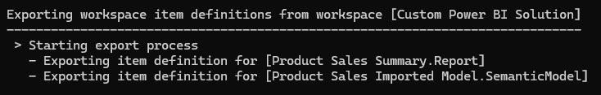
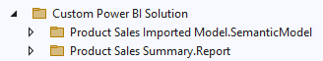
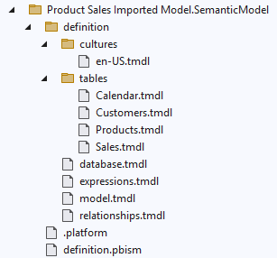
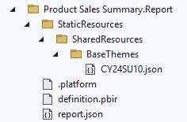
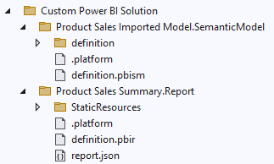
Exporting Custom Power BI Solution
ss

Slide 22
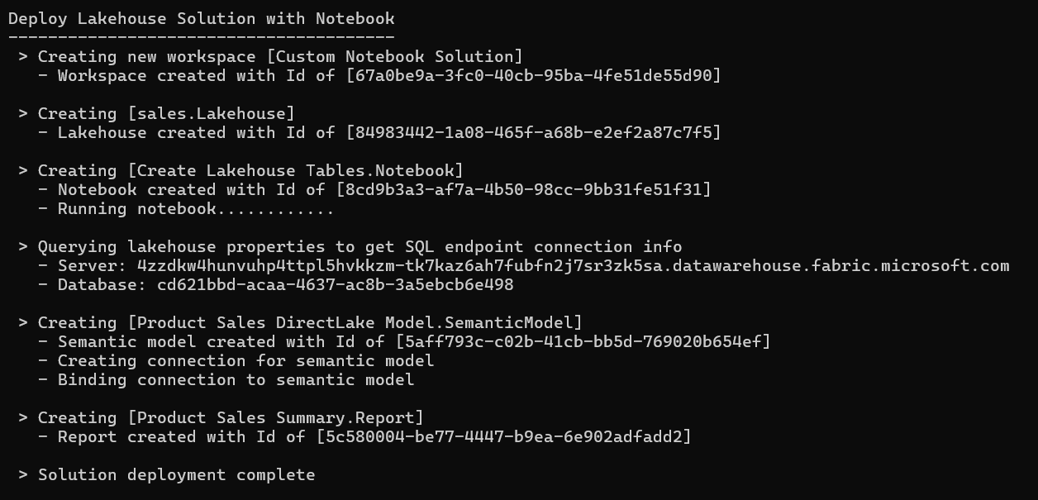
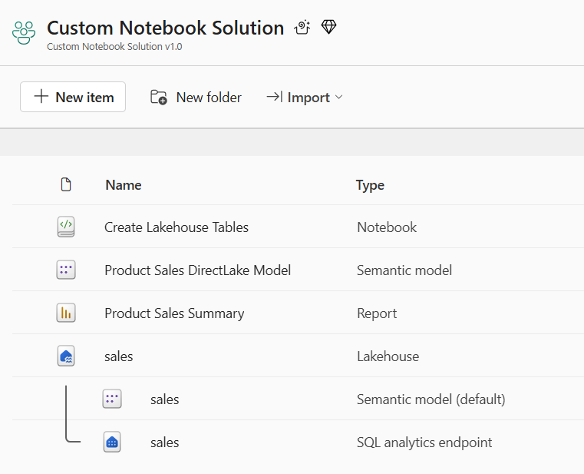
Deploy the Notebook Solution

Slide 23
Sequence of Deployment Steps in Notebook Solution
Create lakehouse
Lakehouse has no dependencies on other workspace items
After creation, track lakehouse id for later use
Query lakehouse properties to discover SQL endpoint server connect string and database Id
Create notebook
Create notebook using updated item definition that includes workspace id & lakehouse id
Run notebook and monitor execution until completion to create lakehouse table schema
Create DirectLake semantic model
Create semantic model using updated item definition that includes SQL endpoint connect string
After creation, track semantic model id for later use
After creation, create & bind connection and then refresh semantic model (if required)
Create Power BI report
Create report using updated item definition that includes semantic model id

Slide 24
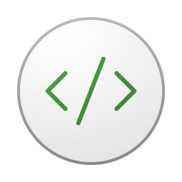

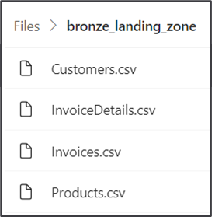
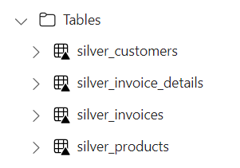
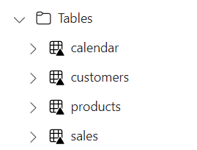


Using Spark Jobs to Create Lakehouse Tables
Fabric provides Spark runtime
Notebooks contain python code commonly used to ingest data files and build tables
Common practice to follow medallion architectures (bronze>silver>gold)
Fabric REST APIs provide Job Scheduler to run notebook and monitor its execution
Customer Tenant Workspace
Environment
Lakehouse
bronze layer
silver layer
gold layer
notebook
Spark job
Spark job
Spark job

Slide 25
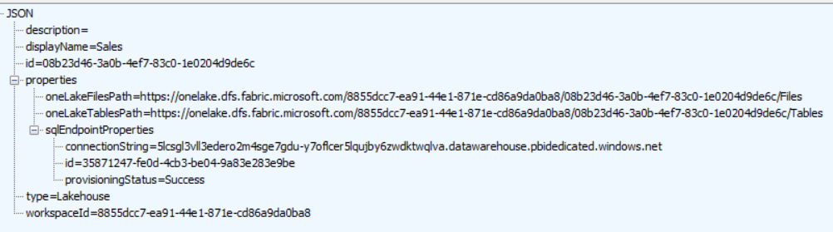
Lakehouse Properties
Retrieve lakehouse properties by executing GET request through /lakehouses endpoint
GET request with target URL of /workspaces/{WORKSPACE_ID}/lakehouses/{LAKEHOUSE_ID}
JSON response provides sqlEndpointProperties data required to create semantic model
SQL Connection Info

Slide 26

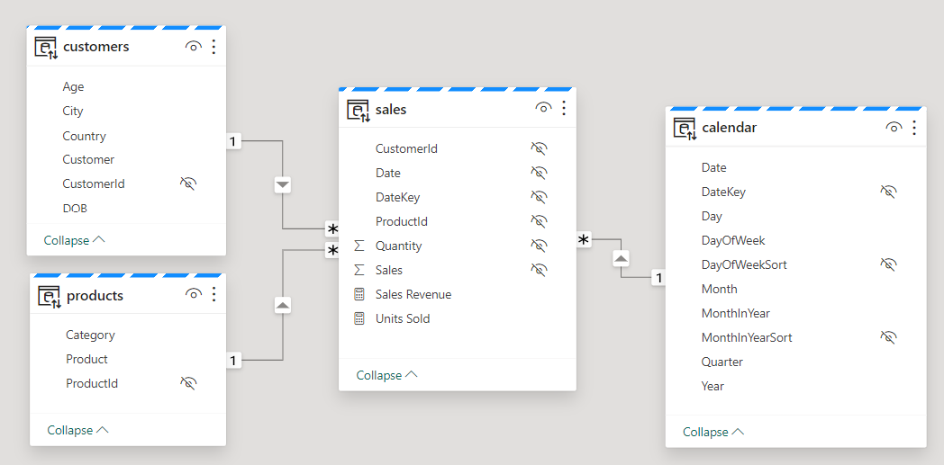
Creating Semantic Models on Lakehouse Tables
Creating semantic model on lakehouse tables uses DirectLake mode
Semantic model created by passing model.bim to Create Item API
Semantic model allow you to define relationships, measures, hierarchies, etc.
CAVEAT: DirectLake semantic models do not support many import-mode features
Customer Tenant Workspace
Lakehouse
Semantic Model (aka Dataset)
SQL Endpoint

Slide 27
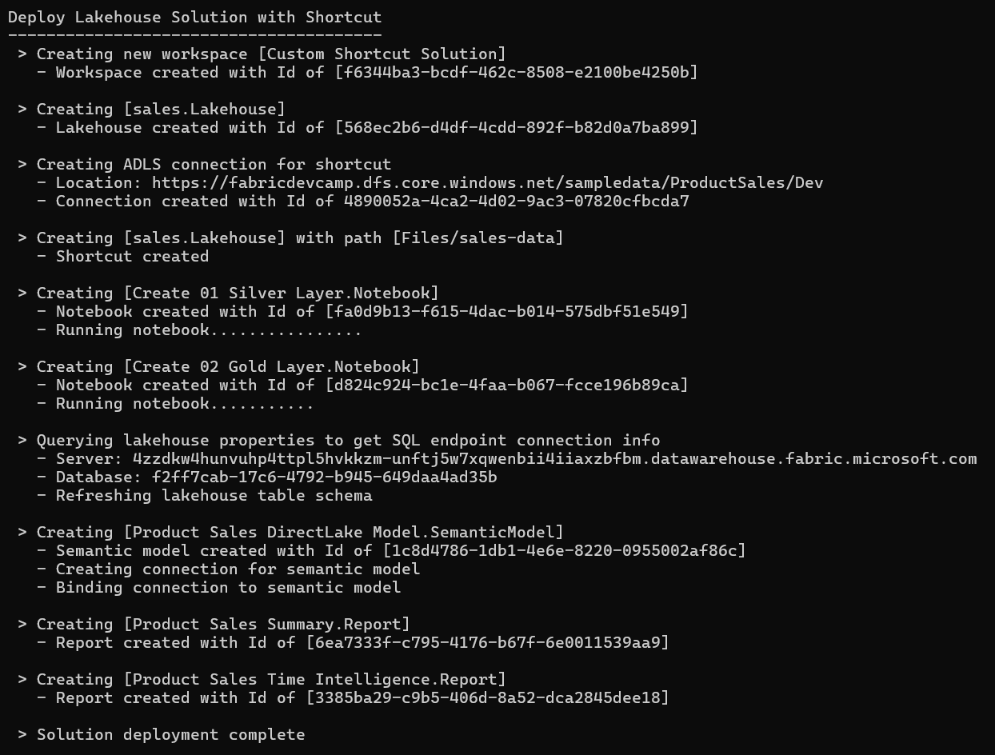
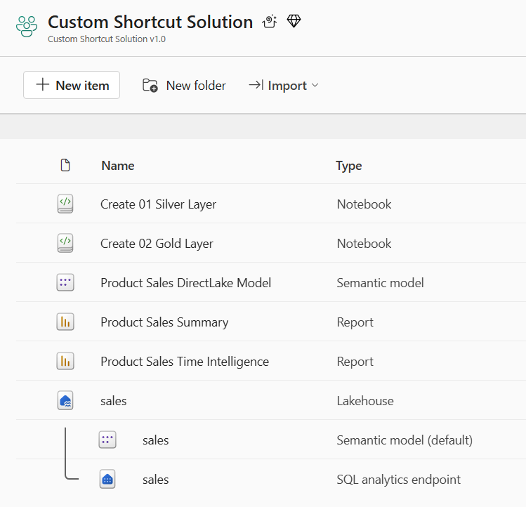
Deploy Shortcut Solution

Slide 28
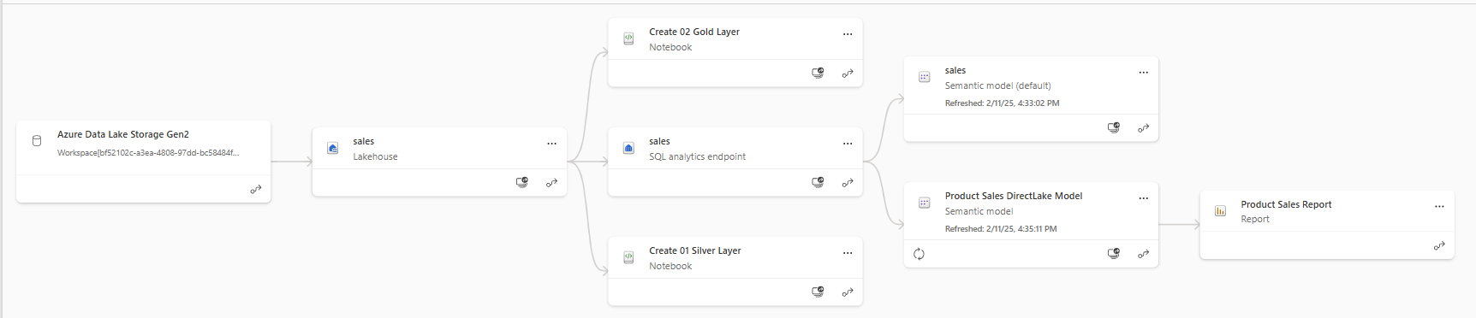
Shortcut Solution Post Deployment
All dependencies are self-contained within the new workspace
There are no dependances on workspace items in other workspaces

Slide 29
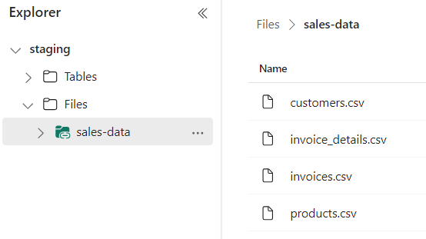
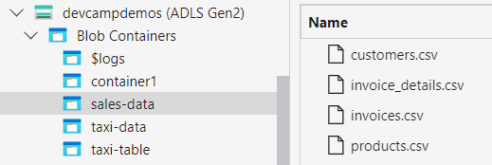
OneLake Shortcut Fundamentals
What is a OneLake shortcut?
A shortcut is an OneLake object that points to another internal or external storage location
Shortcuts can be created in lakehouses and Kusto Query Language (KQL) databases
OneLake supports shortcuts targeting external locations in ADLS, Amazon S3 and Dataverse
Shortcuts behave like symbolic links
Shortcuts are independent objects from the target source
If you delete a shortcut, the target remains unaffected
If you move, rename, or delete a target path, the shortcut can break
Shortcut has unique icons
Shortcut acts as pointer to storage location

Slide 30
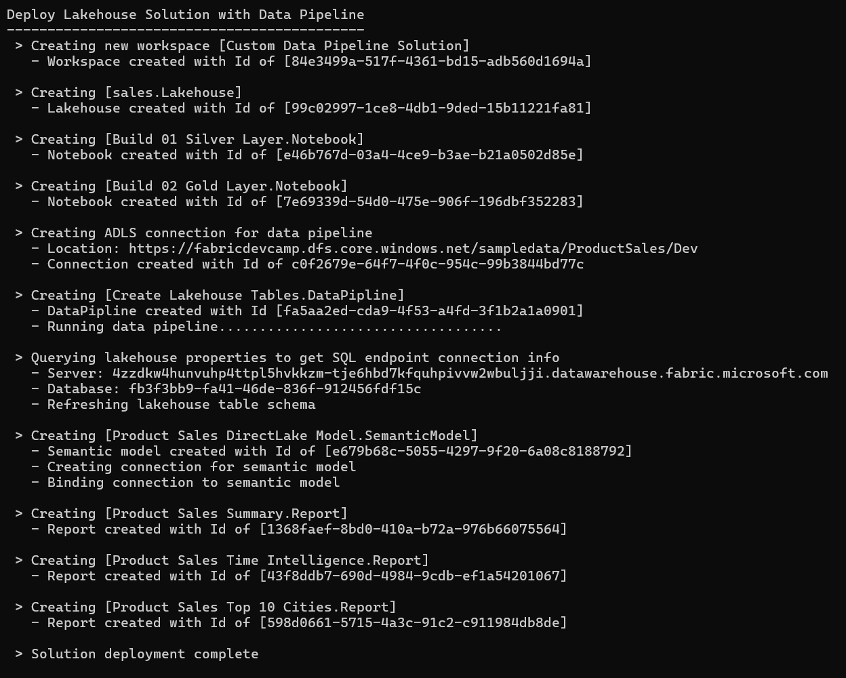
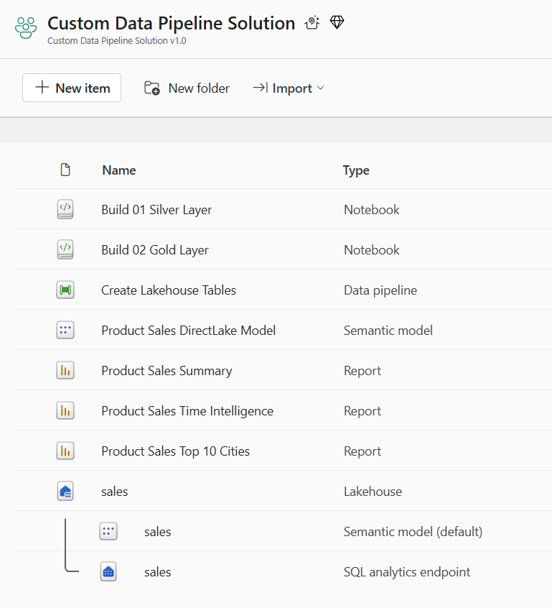
Deploy the Data Pipeline Solution

Slide 31
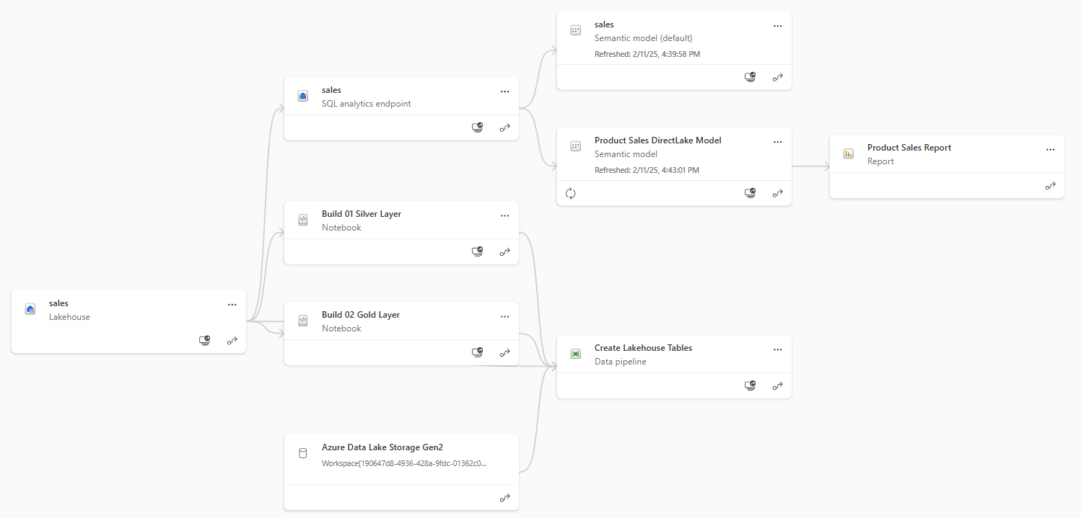
Data Pipeline Solution Post Deployment
All dependencies are self-contained within the new workspace
There are no dependances on workspace items in other workspaces

Slide 32
Agenda
Fabric Strategies for CI/CD and Automating Solution Deployment
Creating Workspace Items using the Fabric REST APIs
Challenges in Fabric CI/CD and Solution Deployment
Configuring Datasource Paths using Deployment Parameters
Deploying and Updating Solutions from a Source Workspace
Exporting and Deploying Solutions using Solution Folders
Connecting Workspaces using Fabric GIT Integration
Setting Up Staged Deployments

Slide 33
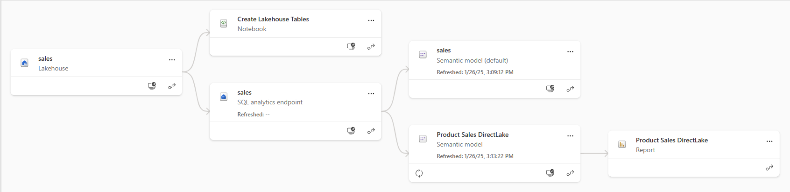
Understanding Workspace Item Dependencies
Many workspace items have dependencies on other workspace items
Lakehouse depends on running notebooks and/or data pipelines to create table schema
Notebook definition depends on workspace id and lakehouse id to reference its default lakehouse
DirectLake semantic model definition depends on connection string to SQL endpoint of lakehouse
Report definition depends on semantic model id
After deployment, solution should not have dependencies on other workspaces
All dependencies should be self-contained in new workspace
Fabric solution deployment requires custom logic to update dependencies accordingly

Slide 34
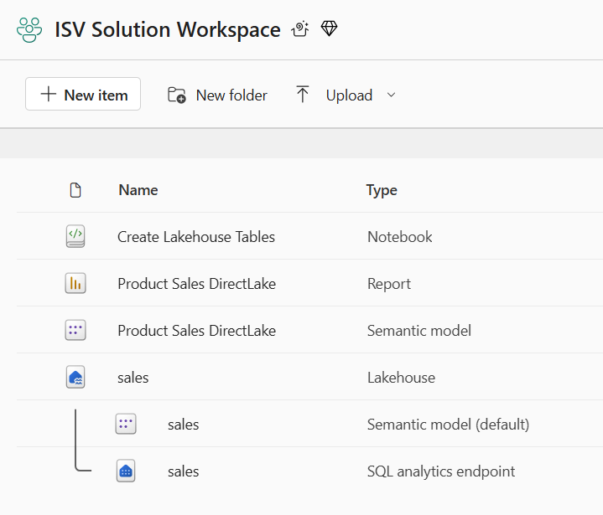
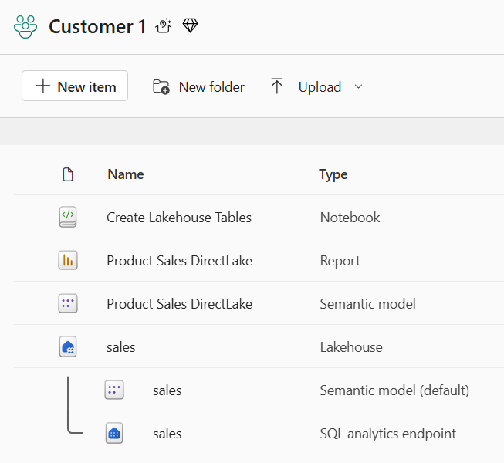
Creating Workspace Items with Dependencies
Deployment workflow must create workspace items with dependencies last
Notebook definition depends on lakehouse id for its default lakehouse
DirectLake semantic model definition depends on connection string to SQL endpoint of lakehouse
Report definition depends on semantic model id
Shallow copy of template workspace is not the result you want
Workspace for customer tenant should not have dependencies on source workspace
Source Workspace
Target Workspace

Slide 35
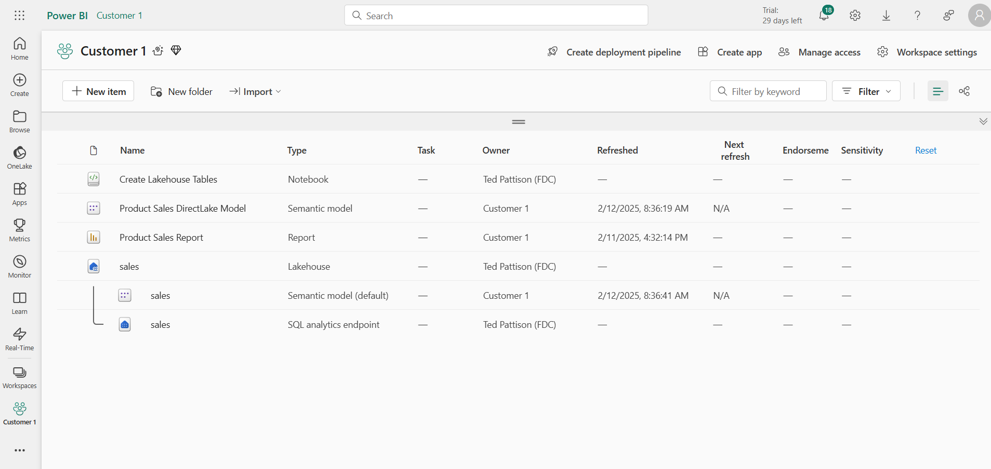
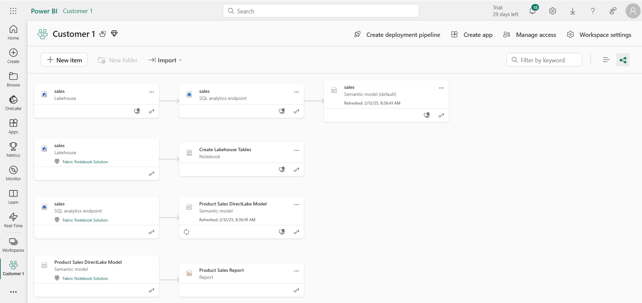
This deployment result IS NOT what you want
Checking for intra-workspace dependencies
Navigate to Lineage view to see item dependencies
Look for items that have dependencies on items in other workspaces

Slide 36
Deployment by Cloning Items from Source Workspace
Fabric items can be cloned using item definitions
Retrieve item definition from source workspace by calling Get Item Definition
Manipulate content of item definition part files such as substitute source Ids for target Ids
Pass manipulated item definition to Create Item API to create new item
Pass manipulated item definition to Update Item Definition API to update existing item
Source
Workspace
Your Application
Target
Workspace
Item
Definition
Item
Definition
Source
Definition
Create Item
Get Item Definition
update
Item
definition
Item
Definition
Updated
Definition
Update Item Definition

Slide 37
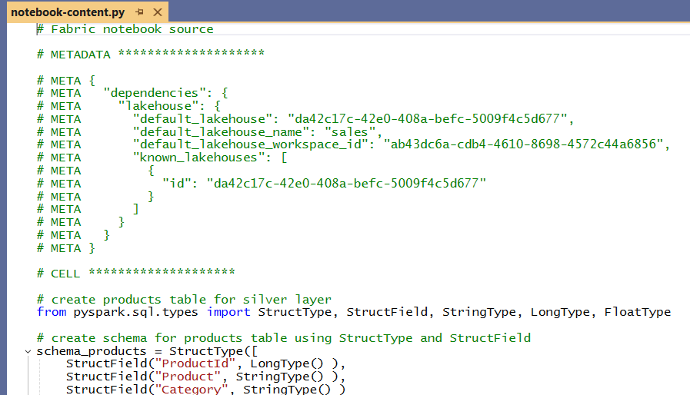
Performing Id Substitution with notebook-content.py
Your Application
Search for | Replace with
source_workspace_id | target_workspace_id
source_lakehouse1_id | target_lakehouse1_id
source_lakhouse2_id | target_lakhouse2_id
source_lakhouse3_id | target_lakhouse3_id
Source
Definition
update
Item
definition
Updated
Definition

Slide 38
Challenge of Managing Connections at Workspace Scope
Unlike workspace items, connection items are scoped at level of Entra Id tenant
No API support for workspace-level management of connections
No support in Fabric GIT integration to track, backup, restore, recreate connections
Developer must find innovative approach for managing connections at scope of workspace
Platform Item Types
Capacity
Workspace
Connection
Gateway
Workspace Item Types by Workload
Power BI
Data Engineering
Data Warehouse
Data Factory
Real-time Intelligence
Data Science
SemanticModel
Lakehouse
Warehouse
DataPipeline
Eventhouse
MLExperiment
Report
Notebook
MirroredWarehouse
Dataflow
Eventstream
MLModel
SparkJobDefinition
KQLDatabase
Environment
KQLQueryset
KQLDashbord

Slide 39
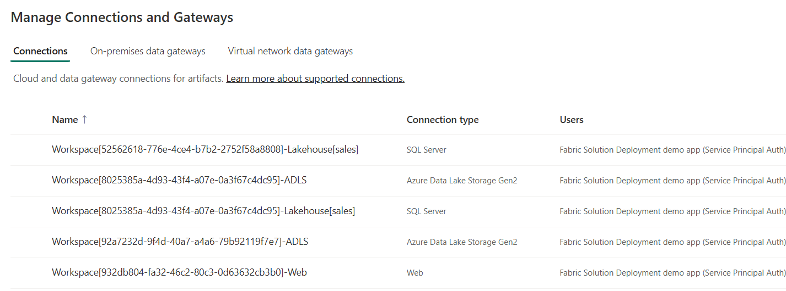
Using a Naing Convention for Managing Connections
Using connection naming convention allows for management at workspace scope
Connection name contains Workspace Id
Connection name also indicates connection type (e.g. Lakehouse(sales) vs ADLS vs Web)
Benefits to connection naming convention
It allows for cascading connection deletes when deleting workspace
Allows for discovery of connection when inspecting source workspace
Enables configuration when recreating lakehouse shortcuts and data pipelines
Workspace[WORKSPACE_ID]-Lakehouse[sales]
Workspace[WORKSPACE_ID]-ADLS
Workspace[WORKSPACE_ID]-Web

Slide 40
Parameterizing Datasource Paths

Slide 41
Agenda
Fabric Strategies for CI/CD and Automating Solution Deployment
Creating Workspace Items using the Fabric REST APIs
Challenges in Fabric CI/CD and Solution Deployment
Configuring Datasource Paths using Deployment Parameters
Deploying and Updating Solutions from a Source Workspace
Exporting and Deploying Solutions using Solution Folders
Connecting Workspaces using Fabric GIT Integration
Setting Up Staged Deployments

Slide 42
Parameterizing Datasources in Staged Deployment
Each stage in staged deployment should connect to its own needs datasource paths
DEV and TEST stage workspaces should not connect to same datasources as PROD
dev stage
test stage
production stage
Dev Workspace
Test Workspace
Prod Workspace
Deploy
or
Update
Deploy
or
Update
Dev DB
Test DB
Production DB

Slide 43
Designing a Source Workspace for a Fabric Solution
Design workspace to serve as solution template to provision customer tenants
Implement DEPLOY workflow to create target workspaces from source workspace
Execute deployment workflow once to create each customer tenant
DEPLOY workflow must support parameterization of customer data such as datasource paths
Customer 1
Workspace
Source Workspace
Solution Deployment Logic
Customer 2
Workspace
Customer 3
Workspace

Slide 44
Parameterizing Customer Data and Datasource Paths
Solution design required to parameterize customer data
Deployment workflow must integrate creation parameters unique to each customer
This is especially true for datasource path
Customer 1 Datasources
Customer 1
Workspace
ADLS Gen2
Storage Container
Azure
SQL Database
Fabric Solution Template
Solution Deployment Logic
Customer 2 Datasources
Customer 2
Workspace
ADLS Gen2
Storage Container
Azure
SQL Database
Customer 3 Datasources
Customer 3
Workspace
ADLS Gen2
Storage Container
Azure
SQL Database

Slide 45
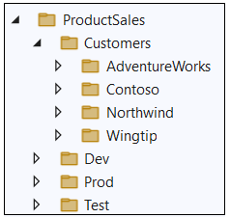
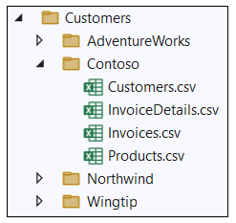
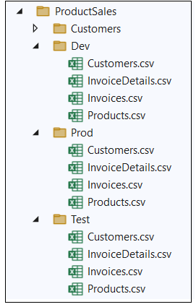
Sample Data Used in FabricSolutionDeployment

Slide 46
Where Do Datasource Paths Live in a Solution
Inside item definition files in semantic models
Example item definitions files with datasource paths include expressions.tmdl and model.bim
Inside Notebooks
Developers can add URLs directly in their python code
In connections
A connection is a credential bound to a datasource path
In shortcut
Shortcut created with datasource path
Shortcut must be bound to connection with same datasource path
In data pipeline
Data pipeline created to reference connection to external datasource
Connection created with target datasource path

Slide 47
Deployment Parameters

Slide 48

Where's the Data Path in an Imported Semantic Model

Slide 49


Slide 50



Exporting Custom Notebook Solution

Slide 51



Slide 52



Slide 53




Slide 54


Slide 55


Slide 56



Adventure Works Sample Data

Slide 57



Contoso Sample Data

Slide 58



Fabrikam Sample Data

Slide 59



Northwind Sample Data

Slide 60



Wingtip Toys Sample Data

Slide 61



Seamark Farms Sample Data

Slide 62
Agenda
Fabric Strategies for CI/CD and Automating Solution Deployment
Creating Workspace Items using the Fabric REST APIs
Challenges in Fabric CI/CD and Solution Deployment
Configuring Datasource Paths using Deployment Parameters
Deploying and Updating Solutions from a Source Workspace
Exporting and Deploying Solutions using Solution Folders
Connecting Workspaces using Fabric GIT Integration
Setting Up Staged Deployments

Slide 63

Deploy Solution from Source Workspace
Solution deployed from source workspace designed as solution template
Developer calls Get Item Definition on source workspace items
Developer modifies item definitions from source to redirect dependencies
Developer calls Create Item to create new item in solution workspace
Deploy Solution Logic

Slide 64
Recreating Source Workspace Connections
ddd

Slide 65
Agenda
Fabric Strategies for CI/CD and Automating Solution Deployment
Creating Workspace Items using the Fabric REST APIs
Challenges in Fabric CI/CD and Solution Deployment
Configuring Datasource Paths using Deployment Parameters
Deploying and Updating Solutions from a Source Workspace
Exporting and Deploying Solutions using Solution Folders
Connecting Workspaces using Fabric GIT Integration
Setting Up Staged Deployments

Slide 66
Exporting for Fabric Solution Deployment
Export workspace to local solution folder and then deploy from local solution folder
Source Workspace
Packaged Solution Folder
Solution
Export
Logic
Solution Deployment Logic
Target
Workspace

Slide 67
Agenda
Fabric Strategies for CI/CD and Automating Solution Deployment
Creating Workspace Items using the Fabric REST APIs
Challenges in Fabric CI/CD and Solution Deployment
Configuring Datasource Paths using Deployment Parameters
Deploying and Updating Solutions from a Source Workspace
Exporting and Deploying Solutions using Solution Folders
Connecting Workspaces using Fabric GIT Integration
Setting Up Staged Deployments

Slide 68

Connecting Fabric Workspace to GIT Repositories
Fabric workspace can be connected to GIT repository
Fabric currently supports GIT repositories in Azure Dev Ops and GitHub
Workspace connections can be configured by hand or through Fabric REST APIs
Once connected, workspace items serialized as item definition files in GIT repository
GIT connection to workspace provides 2-way synchronization
Changes made to workspace items can be synchronized to GIT repository files
Changes committed to GIT repository files can be synchronized to workspace items
GIT
Sync

Slide 69
Connecting Fabric Workspace to GIT Repositories
Fabric workspace can be connected to GIT repository with 2-way synchronization
Fabric currently supports GIT repositories in Azure Dev Ops and GitHub
Once connected, workspace items serialized as item definition files in GIT repository
Changes made to workspace items can be synchronized to GIT repository files
Changes committed to GIT repository files can be synchronized to workspace items
GIT Integrated Serialization

Slide 70
Feature Workspaces
Continuing development performed using branches and feature workspaces
Changes
blah
Dev Workspace
GIT Integrated Serialization
feature01 Branch
main Branch
feature03 Branch
Feature01 Workspace
Feature03 Workspace
pull requests
pull requests
feature02 Branch
feature04 Branch
Feature02 Workspace
Feature04 Workspace
pull requests
pull requests

Slide 71


Workspace settings for Git Integration
Workspace can be connected to Azure Dev Ops repository from Workspace Settings
First, you need to create an Azure Dev Ops project and initialize its main repository
Create workspace connection to ADO repository using Git Integration tab in Workspace Settings dialog
Once connected, workspace items list shows Git status

Slide 72
Fabric GIT APIs
Fabric GIT APIs allow developer to automate creating workspace connections
Connect | Connect a specific workspace to a git repository and branch.
Disconnect | Disconnect a specific workspace from the Git repository and branch it is connected to.
Initialize Connection | Initialize a connection for a workspace that is connected to Git.
Get Connection | Returns git connection details for the specified workspace.
Commit To Git | Commits the changes made in the workspace to the connected remote branch.
Get Status | Returns the Git status of items in the workspace, that can be committed to Git.
Update From Git | Updates the workspace with commits pushed to the connected branch. ConflictResolutionPolicy helps to determine which way to sync: GIT->Workspace or Workspace->GIT
72
Microsoft Fabric
Notes:
Talk about selective commit , changes as part of roadmap
Mention irreversible nature of workspace update from GIT

Slide 73

Item Definitions maintained inside Git-enabled Repository

Slide 74
Agenda
Fabric Strategies for CI/CD and Automating Solution Deployment
Creating Workspace Items using the Fabric REST APIs
Challenges in Fabric CI/CD and Solution Deployment
Configuring Datasource Paths using Deployment Parameters
Deploying and Updating Solutions from a Source Workspace
Exporting and Deploying Solutions using Solution Folders
Connecting Workspaces using Fabric GIT Integration
Setting Up Staged Deployments

Slide 75
Staged Deployment for Enterprise Scenario
High-level architecture for CI/CD on a single target workspace
Changes are propagated to DEV workspace using feature workspaces and pull requests
Changes pushed from DEV to TEST to PROD during testing and approval process
Create customer tenants by running DEPLOY workflow from PROD
Update customer tenants by running UPDATE workflow from PROD
Dev Workspace
Test Workspace
Prod Workspace
feature01 Branch
GIT Integrated Serialization
Custom Serialization
Logic
Custom Deserialization
Logic
Custom Serialization
Logic
Custom Deserialization
Logic
Feature01 Workspace
main Branch
pull requests
feature01 Branch
Feature01 Workspace
pull requests

Slide 76
Parameterizing Datasources in Staged Deployment
Each stage in staged deployment should connect to its own needs datasource paths
DEV and TEST stage workspaces should not connect to same datasources as PROD
dev stage
test stage
production stage
Dev Workspace
Test Workspace
Prod Workspace
Deploy
or
Update
Deploy
or
Update
Dev DB
Test DB
Production DB

Slide 77

Dev Environment Data

Slide 78

Test Environment Data

Slide 79

Prod Environment Data

Slide 80
Staged Deployment for Multitenant Scenario
High-level architecture for CI/CD with multiple target workspaces
Changes are propagated to DEV workspace using feature workspaces and pull requests
Changes pushed from DEV to TEST to PROD during testing and approval process
Create customer tenants by running DEPLOY workflow from PROD
Update customer tenants by running UPDATE workflow from PROD
Dev Workspace
Test Workspace
Prod Workspace
Customer 1 Workspace
feature01 Branch
GIT Integrated Serialization
Custom
Export
Logic
Custom
Import
Logic
Custom
Export
Logic
Custom Deserialization
Logic
Feature01 Workspace
Deploy
or
Update
main Branch
pull requests
Customer 2 Workspace
Deploy
or
Update
feature01 Branch
Feature01 Workspace
pull requests
Deploy
or
Update
Customer N Workspace

Slide 81
Summary
Fabric Strategies for CI/CD and Automating Solution Deployment
Creating Workspace Items using the Fabric REST APIs
Challenges in Fabric CI/CD and Solution Deployment
Configuring Datasource Paths using Deployment Parameters
Deploying and Updating Solutions from a Source Workspace
Exporting and Deploying Solutions using Solution Folders
Connecting Workspaces using Fabric GIT Integration
Setting Up Staged Deployments

Slide 82



























Data icons

Slide 83












































Compute + App Service icons

Slide 84























DevOps (CI/CD + Monitoring) icons

Slide 85






























































































Azure General icons

Slide 86












Fabric + Power Icons

Slide 87































Fabric Icon buttons

Slide 88



Misc

Slide 89




Item Definition Files in GIT Repository
Fabric ALM strategy with CI/CD based on item definition files
Fabric automatically serializes workspace items into set of item definition files
Each type of workspace item defines the set of files that constitutes a valid item definition

